Slide 1

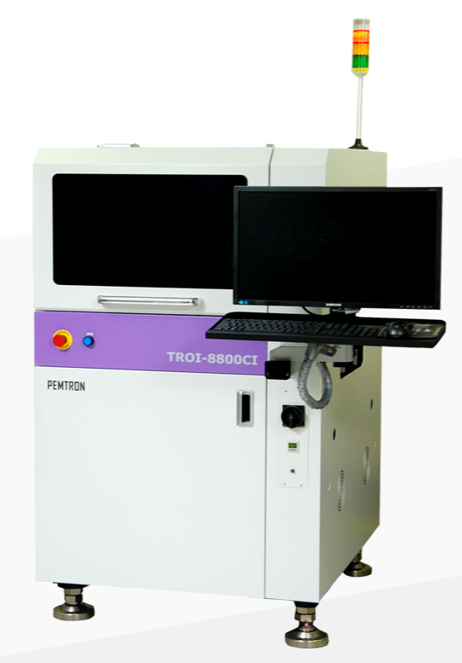
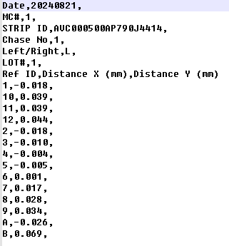
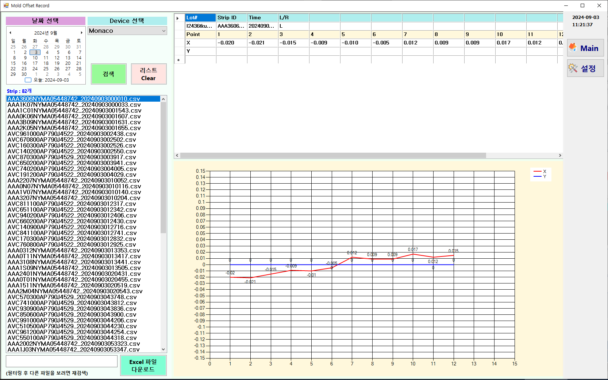

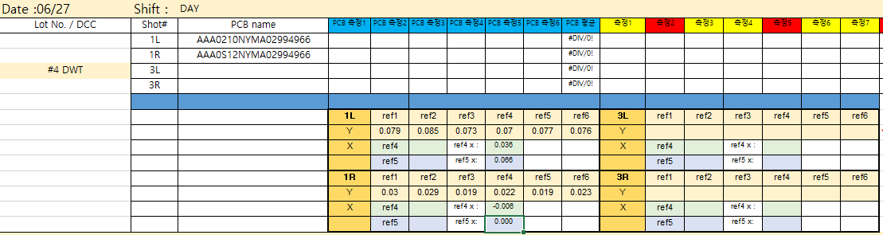

Weekly EED Activity_WW36
K5 / SMD
SMD / Mold
New
K5 SMD, Mold shift offset value management
PE / EED
N/A
N/A
[Problem description]
[Action taken]
Data file is written to the equipment
Check the data directly from the equipment
Recording measurements manually
Device search
Measuring equipment (Pemtron)
Transfer data files to FTP server (.csv)
Developed S/W
Daily data search
Display offset values
Chart display
Download recorded excel files (from. FTP)
Offset value
csv file
File list (.csv)
manual
chart
excel file
Method : Manual Recording
Method : Automatic recording & Chart display
Cost save : $25.0K/5sets (In-house : $5.0K/set)
N/A
HyunSu Park, BeomYeol Kim (DaeGan Ki@PE) / ww36 `24 EED

